Slide 1
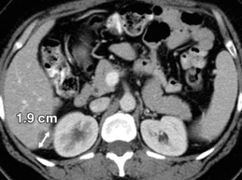
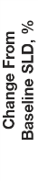
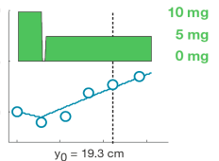
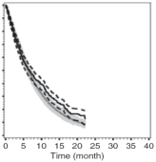
Using longitudinal solid tumor data to improve drug development decisions
Response Criteria for
Solid Tumors (RECIST)
Dose Response
Phase III Survival Prediction
Go/No-Go Decision Making
50
100
80
25
60
40
Target Lesion (%)
Change from Baseline
Overall Survival (%)
0
20
0
0 100 200 300
Time (days)
0 10 20 30 40
Time (months)
ACoP, May 13, 2013
Andrew Stein (Novartis) – presenter
Manish Sharma (University of Chicago)
Rene Bruno (Pharsight Consulting Services)

Slide 2
Background
Oncology Phase III trials have a >40% failure rate¹
Suboptimal Phase III decisions (e.g. dose selection, powering of study, go-no/go) may result from not fully using the available tumor data that is collected.
The pharmacometrics community is developing methodologies that take into account more of the available data, which could potentially lead to more efficient trials and reduced failure rates.
1. DiMasi JA and Grabowski, J Clin. Oncol., 25, 209 (2007)

Slide 3
Overview: Summarize state of the art for modeling tumor data to improve drug development decisions
Describe underutilized longitudinal tumor data.
Example of modeling longitudinal tumor data to support dose selection.
Example of modeling longitudinal tumor data to guide go/no-go decisions. Discuss challenges in validating this approach.
How to address the above challenges in model based go/no-go decision making.

Slide 4
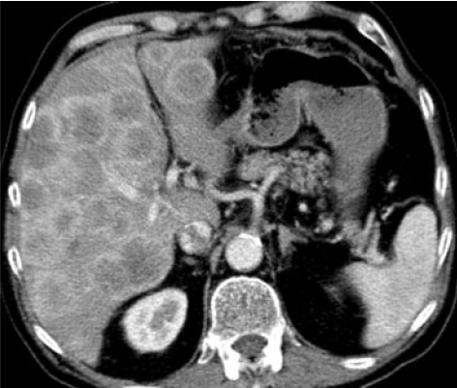
1. Review of tumor data: Which features in data are underutilized?

Slide 5


Background: RECIST¹ lesion types²
Target Lesions
1-2 “representative” lesions per organ
Lesions must be measurable
Sum of the longest diameters (SLD) is computed
Target Lesion
Nontarget Lesions
When >1-2 lesions exist per organ
“Unmeasurable” lesions
Categorical response recorded
Ovarian cancer metastasis in liver
Nontarget Lesions
New Lesions
Detectable only after the start of therapy
Binary response (yes/no) recorded
1. RECIST = Response Evaluation Criteria In Solid Tumors (v1.1)
2. EA Eisenhauer, Eur J. Cancer, 24, 228 (2009)
Rectal cancer metastases in liver.

Slide 6
Background: Patient response is summarized by single value measurements; some information is lost
RECIST¹ data with dosing history
Time (months) | 0 | 2 | 5 | 7 | 10
Dose (mg)
Target Lesion SLD² (cm)
Nontarget Lesion |  | SD | SD | SD | SD
New Lesion |  | No | No | No | Yes
Response |  | PR | PR | PR | PD
10 mg
5 mg
0 mg
Single value measurements:
Time to Progression | 10 mo.
Best Overall Response | PR
Best Percent Change in SLD | 55%
6 cm
4 cm
2 cm
Summary statistics based on single value measurements are then used to compare trial arms
1. RECIST = Response Evaluation Criteria In Solid Tumors SD = Stable Disease
2. SLD = Sum of Longest Diameters of target lesions PR = Partial Response
PD = Progressive Disease

Slide 7
Background: Patient response is summarized by single value measurements; some information is lost
Standard efficacy endpoints (e.g. overall survival, time to progression, best overall response) do not incorporate all available data.
Effect of dose escalations, reductions, and interruptions on efficacy is ignored.
Continuous lesion response is reduced to binary variables (Progression: yes/no, Response: yes/no).

Slide 8
2. Assessing Dose-Response using longitudinal tumor data
RECIST¹ data with dosing history
Time (months) | 0 | 2 | 5 | 7 | 10
Dose (mg)
Target Lesion SLD² (cm)
Nontarget Lesion |  | SD | SD | SD | SD
New Lesion |  | No | No | No | Yes
10 mg
5 mg
0 mg
6 cm
4 cm
2 cm
1. RECIST = Response Evaluation Criteria In Solid Tumors SD = Stable Disease
2. SLD = Sum of Longest Diameters of target lesions PR = Partial Response
PD = Progressive Disease

Slide 9
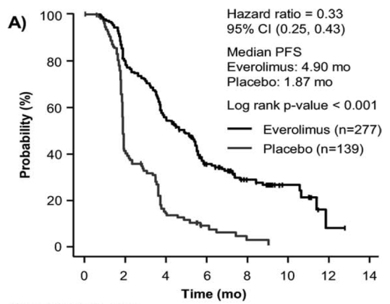
Example: clinical trial comparing 10mg everolimus to placebo in renal cell cancer
RAD001C2240: Phase III pivotal trial comparing everolimus 10mg to placebo in 2nd/3rd line renal cell cancer patients.
Progression free survival was the primary end point.
Results demonstrated superiority of everolimus 10mg over placebo.
Comparison of trial arms:
Log rank p-value < 0.001
% of pts. who have not progressed
Everolimus (N=277)
Median PFS = 4.9 mo
Placebo (N=139);
Median PFS = 1.9 mo
Time after randomization (months)

Slide 10
Background: The RAD001C2240 trial with no 5mg arm contains information about the 5mg response.
Many patients (N=98) were dose- reduced from 10mg to 5mg due to adverse events
Is 10mg superior to 5mg? Should patients who are dose-reduced to 5mg be re-challenged with 10mg?
Standard statistical tools cannot answer these questions because there was no prospective 5mg arm in the trial.
Model-based tools can address these questions by relating the daily dosing history to tumor response over time.
Individual Patient
10mg
5mg
Dose reduction due to an adverse event
Observed solid tumor data from an individual patient: In this patient, target lesions appear to shrink under 10mg, but grow under 5mg.

Slide 11
Methods: model based approach for describing individual patient data.
Modeling approaches describe the daily change in tumor size for each individual patient¹⁻⁴.
Tumor Size (y [cm] )
Change over Time (t [days])
Placebo
Growth Rate [cm/day]
Drug
Effect
[cm/day]
=
–
dy/dt
=
r
–
[Eff_{dose(t)}]*y
Using each individual’s dosing history and longitudinal tumor size data, we fit all patients from the trial using a nonlinear mixed effect (NLME) model.
A. Stein et al., BMC Cancer, 12, 311 (2012)
L. Claret et al., J. Clin. Onc. 27, 4103 (2009)
L. S. Tham et al., Clin. Canc. Res. 14, 4213 (2008)
S. Mu et al. ACoP Meetings Abstract (2009)

Slide 12
Results: The model well describes representative patient data. 10mg was more effective than 5mg.
KEY
Sum of Longest Diameters (SLD)
Dose
Model fit
10mg
5mg
0mg
Placebo patients that cross over to Everolimus
10mg
5mg
0mg
Patients on 10mg
10mg
5mg
0mg
Patients reduced from 10mg to 5mg

Slide 13
Validation: Standard PKPD diagnostics can be used for model validation.
Weighted Residuals (WRES)
Goodness of Fit
Visual Predictive Check (VPC)
Eta-Shrinkage
r
E₁₀

Slide 14
Conclusions: Modeling approaches can describe response to 5mg, even without a 5mg arm
Analysis supports 10 mg as starting dose.
Analysis demonstrates that 5 mg is superior to placebo when dose reductions are necessary.
Analysis suggests that patients who are dose-reduced to 5 mg may benefit from a re-challenge at 10 mg.
Results were published in BMC Cancer¹.
Simulation
Error bars denote intersubject-variability in tumor size (±35%)
1. Stein et al., BMC Cancer, 12:311, 2012

Slide 15
Summary: Application of dose-PD and PKPD models for dose selection
Models have been developed and applied to optimize dose selection both before and after Phase III
Models can be readily validated in each application using standard PKPD diagnostic methods.
Next steps in dose-PD modeling of tumor growth
Describing the nontarget and new lesions
Describing the heterogeneous response of individual lesions
Exploring other metrics of tumor size (e.g. volume)
Incorporating additional biomarkers into models (e.g. circulating tumor cells)

Slide 16
3. Predicting overall survival for guiding trial design and go/no-go decision making
RECIST¹ data with dosing history
Time (months) | 0 | 2 | 5 | 7 | 10
Dose (mg)
Target Lesion SLD² (cm)
Nontarget Lesion |  | SD | SD | SD | SD
New Lesion |  | No | No | No | Yes
10 mg
5 mg
0 mg
6 cm
4 cm
2 cm
1. RECIST = Response Evaluation Criteria In Solid Tumors SD = Stable Disease
2. SLD = Sum of Longest Diameters of target lesions PR = Partial Response
PD = Progressive Disease

Slide 17
Methods: The FDA developed a model based approach¹ for predicting overall survival in NSCLC²
Modeling approach can be used to predict overall survival in Phase III based on tumor size measurements in Phase II.
Survival
[Days]
ECOG³ Performance Status [0,1,2,3]
Baseline
Tumor Size
(y_{baseline})[cm]
Week 8
Change in
Tumor Size
(Δy_{8week})[%]
=
~
log(Survival Time)
~
a₁*ECOG
+
a₂*y_{baseline}
+
a₃*Δy_{8week}
Change in tumor size can be based on actual data or model interpolation
{a₁, a₂, a₃} are coefficients linking each assessment to survival.
FDA used a parametric log-normal survival model to fit >3000 NSCLC pts.
1. Wang et al. Clin. Pharm. Ther., 86, 167-174 (2009) 3. ECOG = European Cooperative Oncology Group
2. NSCLC = Non-Small Cell Lung Cancer

Slide 18
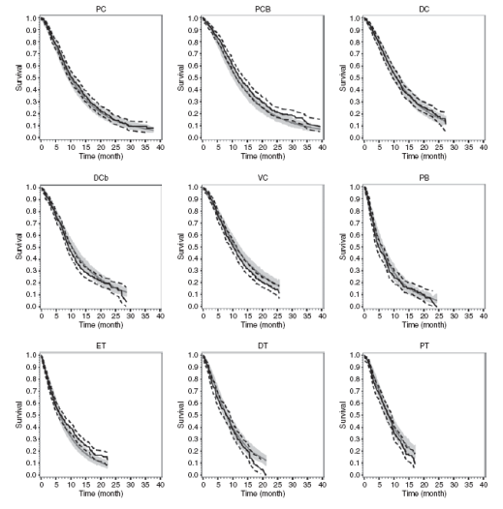
Results: FDA fit models to nine different trial arms. Models described the data well.
paclitaxel+carboplatin
+bevacizumab
paclitaxel+carboplatin
docetaxel+cisplatin
100
The same model with was used to describe >3000 patients from four different trials.
Regression coefficients {a₁,a₂,a₃} differed only between 1st and 2nd line therapy.
The same model was then used to prospectively predict the results of the MONET1 study comparing P/C¹ to P/C¹ + motesanib (VEGF inhibitor)
80
60
Overall Survival (%)
40
20
0
docetaxel+carboplatin
vinorelbine+cisplatin
placebo
100
80
60
Overall Survival (%)
40
20
0
erlotinib
docetaxel
pemetrexed
100
80
Data
Model
60
Overall Survival (%)
40
20
0
10 20 30 40
Time (months)
0 10 20 30 40
Time (months)
0 10 20 30 40
Time (months)
Paclitaxel + Carboplatin

Slide 19

Result: FDA model used to prospectively predict Phase III outcome.
Prediction was correct.
Paclitaxel +
Carboplatin +
Motesanib
 | Hazard Ratio | Confidence Interval
Model Prediction¹ (2010) | 0.87 | 0.71-1.1
Probability of Survival
Clinical Result² (2012) | 0.90 | 0.78-1.0
Paclitaxel +
Carboplatin
Time (months)
1. R Bruno et al. J Clin Oncol 28, 2010 (abs)
2. L Claret et al. Clin Pharmacol Ther 92, 631-634, (2012)

Slide 20
Model Validation in Non Small Cell Lung Cancer More data is needed (especially in successful trials)
External Validation
Correctly Predicted Trials: Failure
(HR_{upper95%} >1)
Observed
Hazard Ratio
(upper 95% CI)
Correctly Predicted Trial: Success
(HR_{upper95%} <1)
Right shift in data means model predictions are conservative
Predicted Hazard Ratio (upper 95% CI)
L Claret et al., Clin. Pharm. Ther. 92, 631 (2012) Y Wang et al., Clin. Pharm. Ther. 86, 167 (2009)
W Sallas et al. ACoP (2011)

Slide 21
Validation: Survival prediction literature is growing, but more examples of model validation are needed.
Cancer | Num. Trials | Num. model tests using external data | References
Non-small cell lung cancer | 11 | 2 | Y Wang et al., Clin. Pharm. Ther. 86, 167 (2009) W Sallas et al., ACoP Poster (2011) L Claret et al., Clin. Pharm. Ther. 92, 631 (2012)
Colorectal cancer | 5 | 1 | L Claret et al., J. Clin. Onc. 27, 4103 (2009) L Claret et al., J. Clin. Onc. In press (2013)
Breast cancer | 3 | 1 | L Claret et al., J. Clin. Onc., 24, 6025 (2006) R Bruno et al., Clin. Pharm. Ther.: Pharmacometry System Pharm. 1, e19 (2012)
Multiple Myeloma | 3 | 1 | R Bruno et al., Blood 118, 1881 (Abstract) (2011)
Ovarian cancer | 2 | 0 | L Lindborn et al., ACoP Poster (2009)
Gastrointestinal stromal tumors | 1 | 0 | EK Hansson et al., PAGE Abstract A-28 (2011)
Thyroid cancer | 1 | 0 | L Claret et al., Canc. Chemother. Pharm. 66, 1141 (2010) J Lu et al., Canc. Chemother. Pharm. 66, 1151 (2010)

Slide 22
Lit Review: Other metrics are also available for predicting survival. Best metric is not yet known.
RECIST¹ data with dosing history
Time (months) | 0 | 2 | 5 | 7 | 10
Dose (mg)
Target Lesion SLD² (cm)
Nontarget Lesion |  | SD | SD | SD | SD
New Lesion |  | No | No | No | Yes
Response |  | PR | PR | PR | PD
Change in tumor size at first assessment
10 mg
5 mg
0 mg
Tumor dynamic metrics that account for longitudinal time course of the target lesions¹⁻³
Time to tumor growth
6 cm
4 cm
2 cm
Full tumor response at first assessment metrics account for all lesion types⁴⁻⁶
L Claret et al., JCO in press (2013)
M Maitland et al., CPT 93, 345 (2013)
E Stein et al., Oncologist, 13, 1046 (2008)
Multivariate longitudinal data metrics can take into account all available data⁷
W Mietlowski et al., JCO, 30, 10602 (2012)
A Stein et al., Eur. Uro, in press (2013)
Suzuki et al., Ann. Onc., 23, 948 (2012)
A Stein et al., JCO, 4602 (2011)

Slide 23
Conclusions: Outcome of Phase III trial was prospectively predicted using model-based approach
Models linking tumor size to overall survival have been developed and are publicly available
The model has been used to prospectively predict the difference in survival (hazard ratio) between two arms in a Phase III clinical study based on Phase II data.
Prediction of the hazard ratio based on early tumor growth inhibition data (Phase Ib, II) can be used to support:
Go/no go decision making
Phase III clinical trial design
More examples of model validation are needed.
Further work is needed to identify the most predictive factors of overall survival.

Slide 24
Comparison of the two modeling methods for guiding decision making.
 | Dose selection | Phase III go/no-go
Modeling approach | Dose/Exposure Response | Survival Prediction
50
100
80
25
60
40
Target Lesion (%)
Change from Baseline
Overall Survival (%)
0
20
0
0 100 200 300
Time (days)
0 10 20 30 40
Time (months)
Goal | Understand response to new drug
Validation | Standard diagnostics
Number of Trials Needed | One
Predicting response of new drug
Pool many studies
Many

Slide 25

Validation of PKPD models for guiding dose selection can be done using a single trial.

Slide 26

Validation of survival models for go/no-go decision making requires a global effort.

Slide 27

Collaboration across academia, industry, and health authorities is needed to validate predictive models.
ISoP Subteam Formation
An ISoP subteam could help in moving the discussion forward and planning the next steps.
Knowledge Integration
Develop website (e.g. ISoP wiki) to provide a repository of literature, code, and recommendations for further validating models
Data Liberation
As individualized data becomes more publicly available, validation may become easier.

Slide 28
Acknowledgements
Novartis
Pharsight
Gabriel Helmlinger
Celine Sarr
Jerry Nedelman
Bill Sallas
Varun Goel
Wenping Wang
Ovidiu Chiparus
Alison Carter
Shu Yang
Marina Savelieva
Olesya Melnichenko
Christina Vasalou
Kyle Lemoi (Intern)
Daniel Lusk (Intern)
Bill Mietlowski
Norbert Hollaender
Dennis Kim
Sandra Chica
Dean Bottino
Anna Georgieva
Don Stanski
Pascal Girard (now with Mark-Serono)
Laurent Claret
Francois Mercier

Slide 29
backups

Slide 30
Everolimus showed similar effect on target lesions among patients with and without dose reductions.
Because there was not a randomized 5mg arm, the patients who are dose-reduced to 5mg represent a biased sample of patients who experience an adverse event.
We compare the 10mg drug effect for patients with and without dose-reductions to see if tumor shrinkage is different across the different subgroups.
The right hand plot demonstrates that the effect of 10mg on tumor size is similar for both subgroups of patients, irrespective of whether the patient had an adverse effect.
Drug Effect in patients without (left) and with (right) dose interruptions is similar for both groups.

Slide 31
Lit. Review: A diverse range of PD tumor growth models have been applied to clinical oncology data
Ref. | Permit Dose Change | Placebo Model | Model eqn: y = tumor size, g = growth rate, E = drug effect
1 | No | Linear | y(t) | = |  |  | gt | - | Ee^{-λt}
2 | No | Linear | y(t) | = | y₀ | + | gt | - | Ey
 | No | Linear | y(t) | = |  |  | gt | + | y₀*t^{-E}
3 | No | Expon. | y(t) | = | C₀ | + | G₀e^{gt} | - | E₀e^{-Et}
4 | Yes | Linear | dy/dt | = |  |  | g | - | Ey
5 | Yes | Expon. | dy/dt | = |  |  | gy | - | Eye^{-λt}
6 | Yes | Logistic | dy/dt | = |  |  | gy | - | Ey²
7 | Yes | Gompertz | dy/dt | = |  |  | gy | - | Eylogy
Because models are validated based on their ability to describe and simulate clinical data, evaluating which model is “best” is not critical.
Y. Wang et al., Clin. Pharm. Ther. 86, 167 (2009)
M. Maitland et al., Clin. Pharm. Ther. 93, 345 (2013)
E. Stein et al., Oncologist 13, 1046 (2008)
A. Stein et al., BMC Cancer, 12, 311 (2012)
L. Claret et al., J. Clin. Onc. 27, 4103 (2009)
L. S. Tham et al., Clin. Canc. Res. 14, 4213 (2008)
S. Mu et al. ACoP Meetings Abstract . 2009,

